Slide 1

Table of Contents
Introduction
Exploratory Data analysis
Problems
Problem 1
Problem 2
Problem 3
Learning outcome

Slide 2





Introduction
Dataset : What’s cooking?
Reason for choosing this dataset : It requires us to work with strings instead of integers
Our general objective:
Describe, explore and analyze various relationships between different cultures and ingredients.
Our specific objectives:
Analyse which cuisines are easier to pick up amongst the different types of cuisines
Analyse which cuisines are generally healthier as compared to others, based on selected ingredients
Predict the type of cuisine based on selected input ingredients using machine learning model

Slide 3

Exploratory Data Analysis

Slide 4
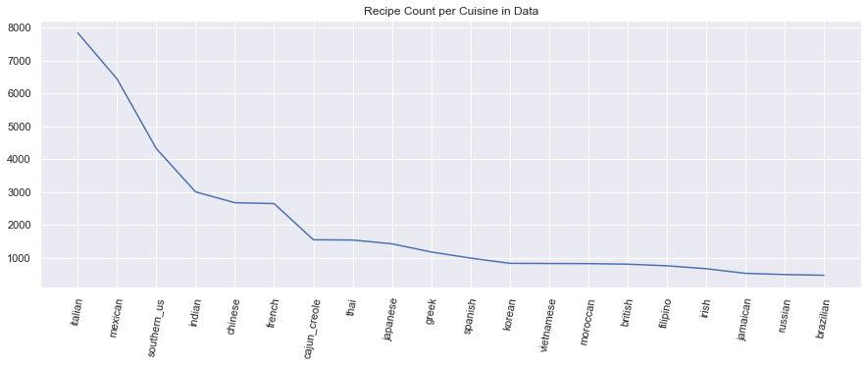
Basic Exploratory Data Analysis
Number of each culture’s cuisine in the data
Notes:
Here we can see the density plot count for each type of cuisine in the dataset. We can basically see here that the dataset contains the most amount of italian cuisines, and braziliian cuisines
are available in the smallest amounts.

Slide 5
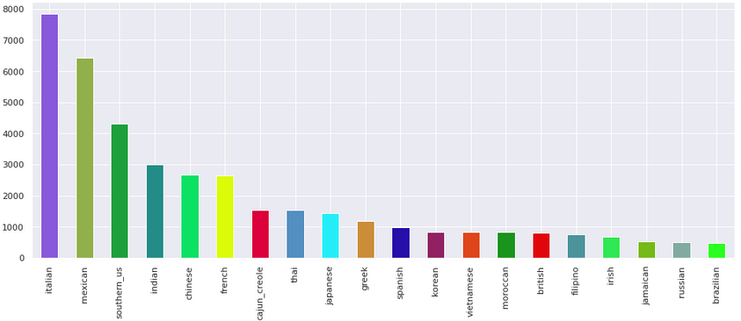
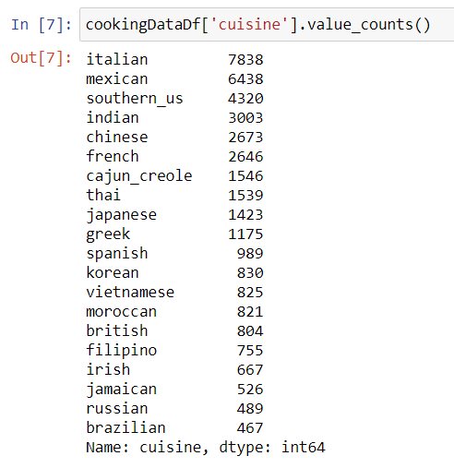
Basic Exploratory Data Analysis
We tallied the number of each type of cuisine available in the dataset
Number of each culture’s cuisine in the data
Notes:
For a more detailed analysis we made a barplot, and we can observe the respective number of each type of cuisine on the right as we did using value_counts.

Slide 6
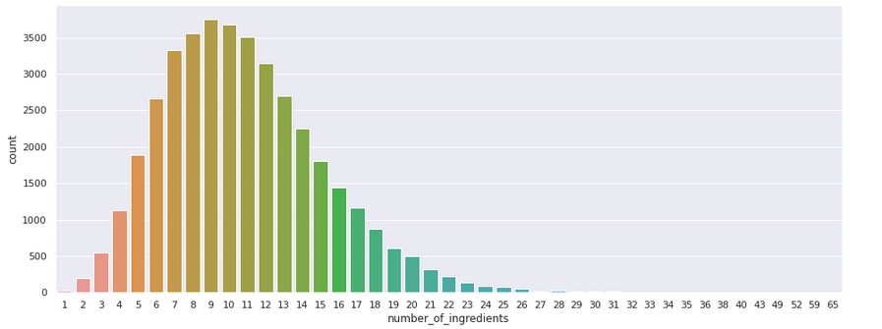
Basic Exploratory Data Analysis
Distribution of number of ingredients per dish
Notes:
Distribution, median 9
Daniel end

Slide 7
Cultural Analysis

Slide 8
Problem 1
What are the commonly used ingredients found? Is the preparation of cuisine difficult?
Notes:
Onions & Olive oil classified as healthy ingredients by American Cancer Society.
Rich in Oleic Acid, a Very Healthy Fat

Slide 9
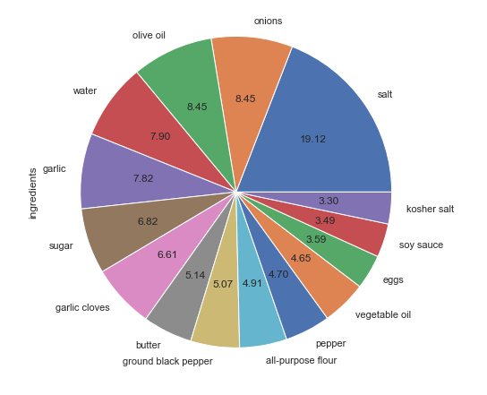
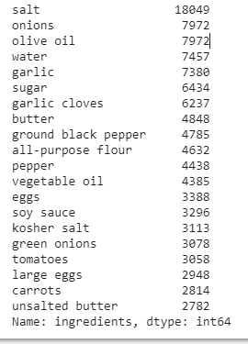
Top Ingredients (All Cuisines)
Extract of the top 15 ingredients used across all cuisines
Notes:
We gathered the top 20 ingredients used across all cuisines, and can observe that salt, onions and olive oil are used amongst the top 3 most used ingredients. The actual percentages can also be seen on the right in the pie chart.

Slide 10
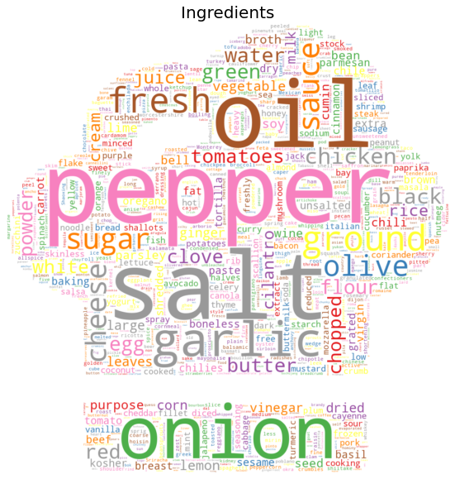
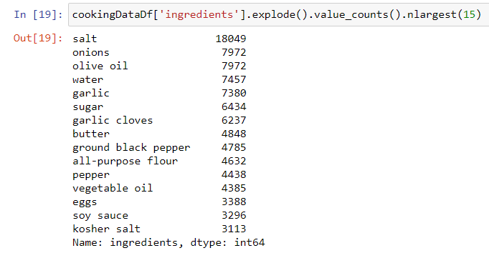
Top Ingredients (All Cuisines)
Notes:
Mention the use of wordcloud

Slide 11
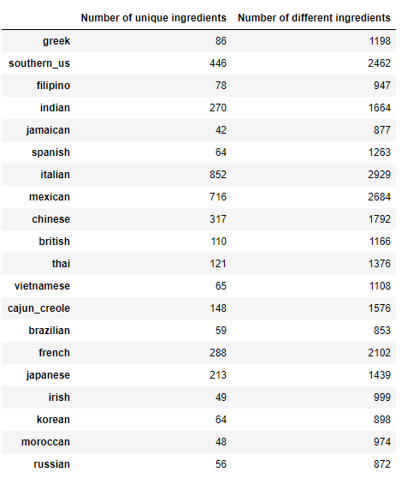
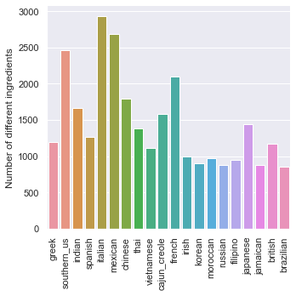
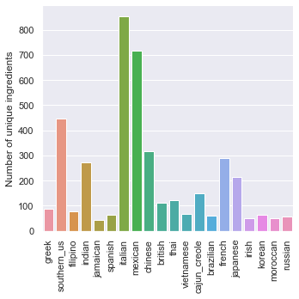
Cultural Analysis
No. of Different Ingredients (Highest) | No. of Different Ingredients (Lowest) | No. of Unique Ingredients (Highest) | No. of Unique Ingredients (Lowest)
Italian Cuisine (2929) | Brazillian Cuisine (853) | Italian Cuisine (852) | Jamaican Cuisine (42)
Number of unique ingredients in each cuisine
Notes:
Here we can see a more intuitive breakdown of the number of UNIQUE ingredients in each country. This is basically the same data that we saw in the previous slide, but in a more digestible form.

Slide 12
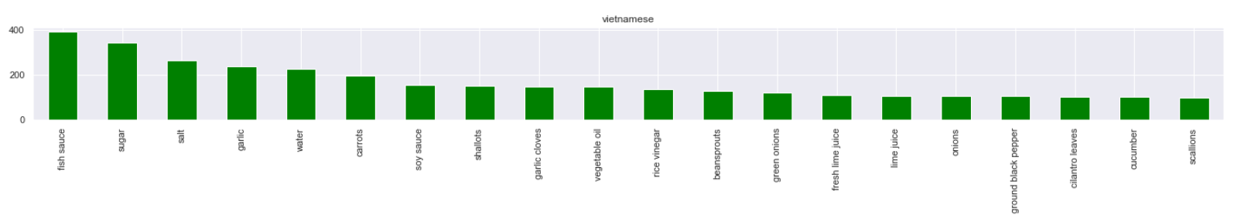
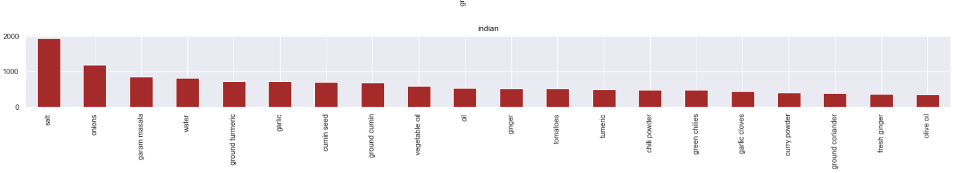
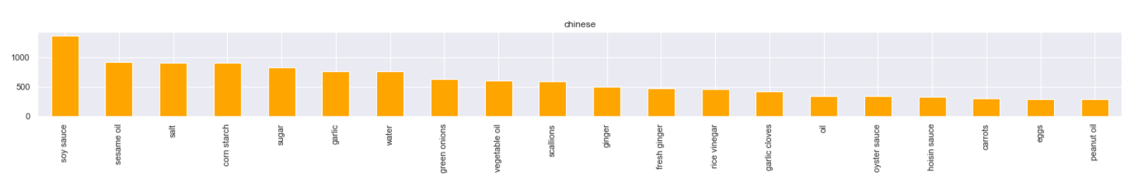
WHICH ARE THE MOST POPULAR INGREDIENTS IN EACH CUISINE?

Slide 13
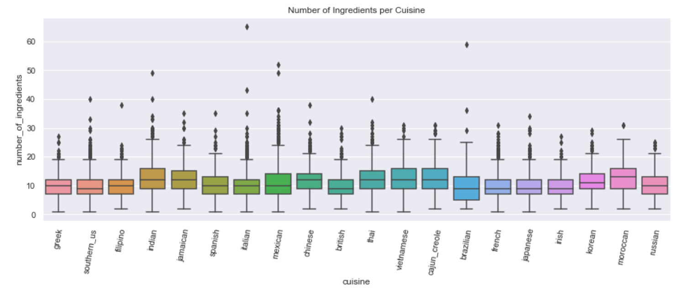
Data Exploration (Complexity of Cuisines)
Notes:
Here, we can observe the complexity of each type of cuisine. We can observe that

Slide 14
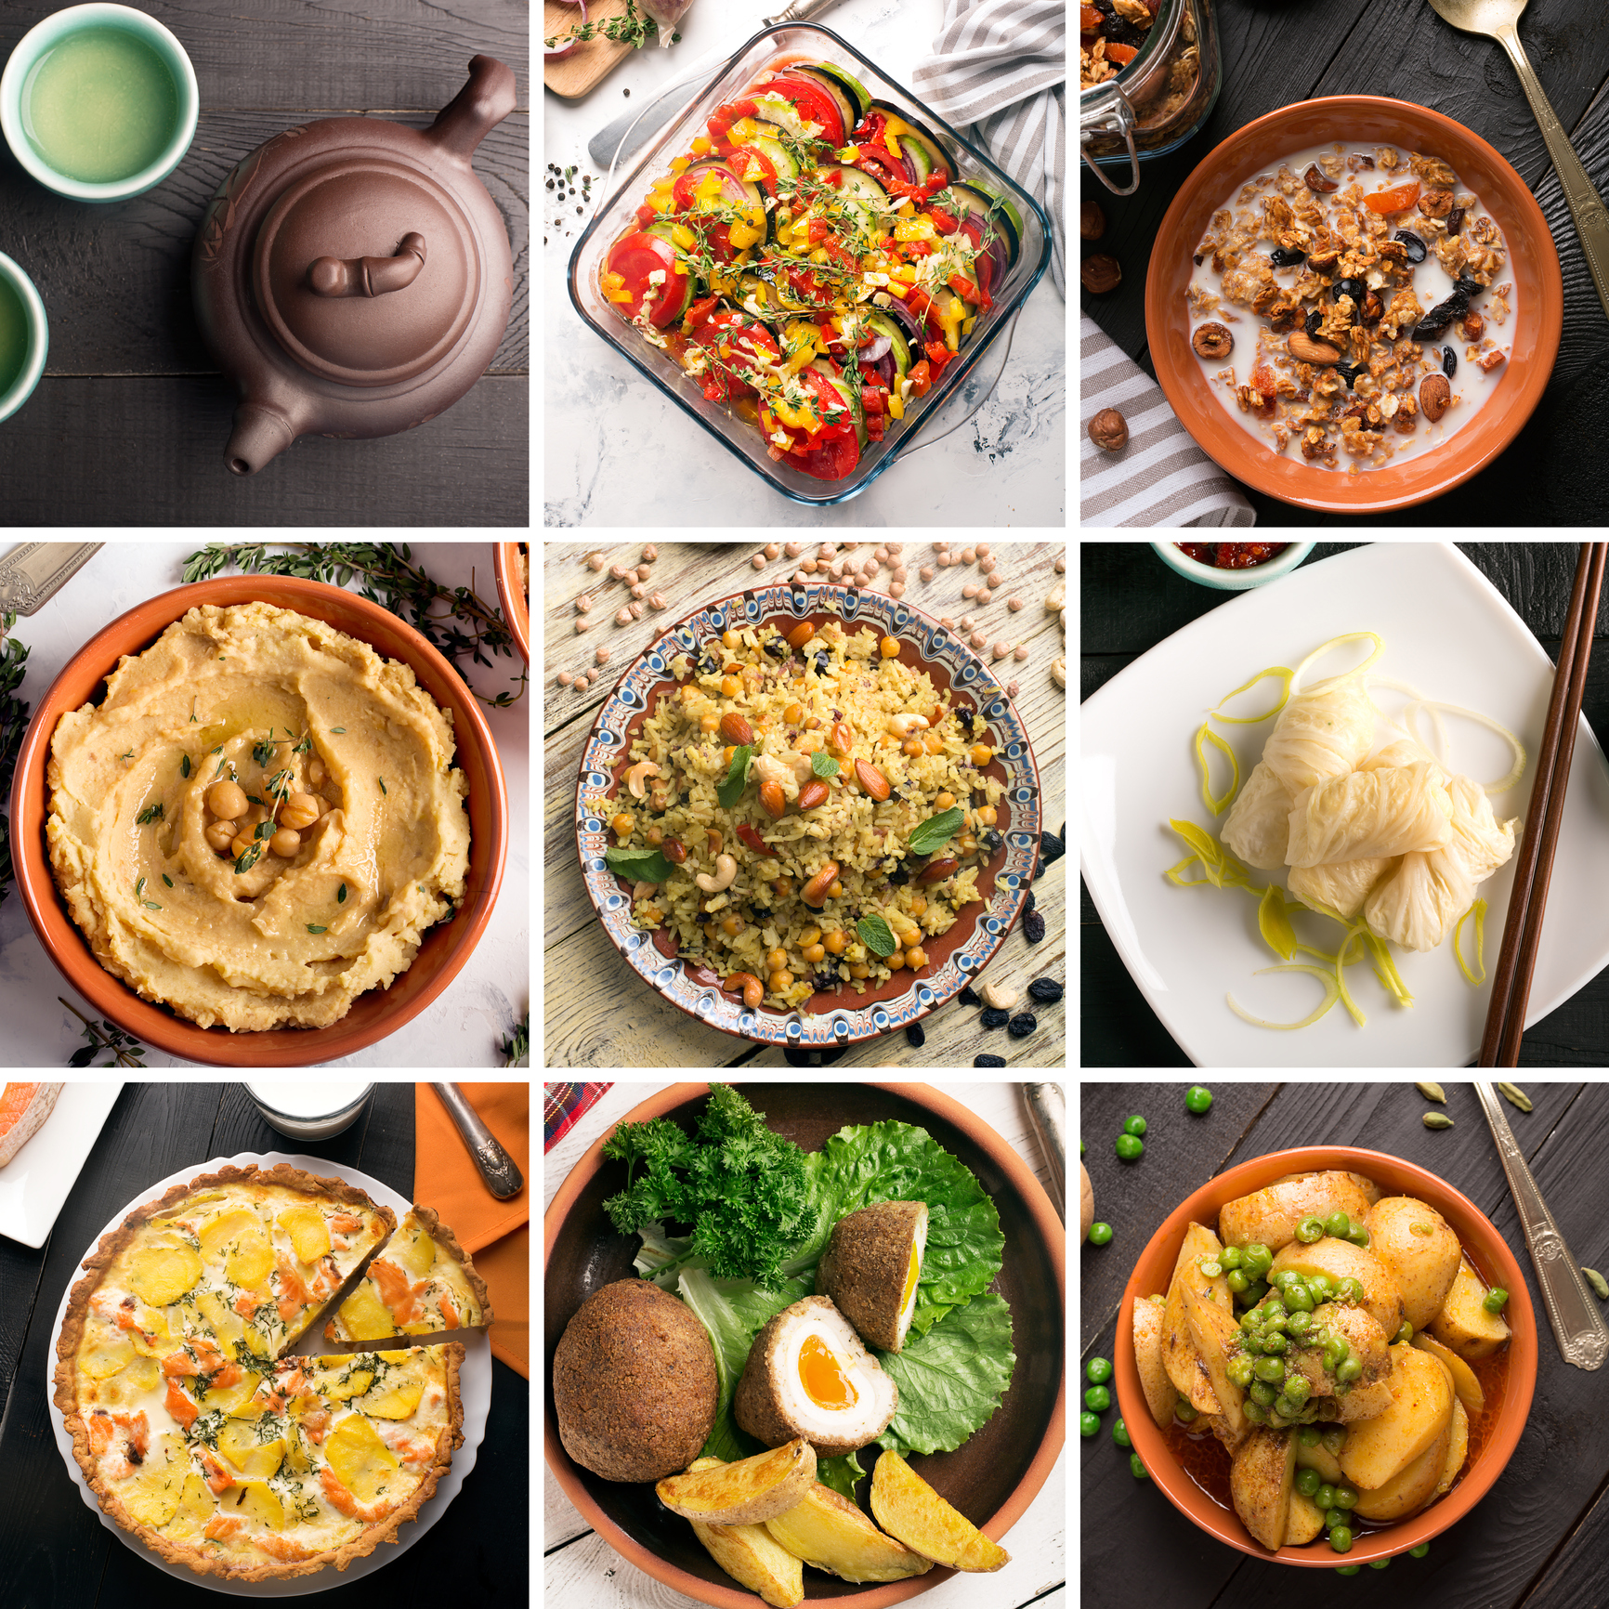
What problem have we solved?
If we are new to cooking, we can choose what kind of cuisine is easier to learn first (Based on complexity)
Allows us to analyse the various health aspects of each cuisine (An example will be shown in the next slide)

Slide 15
Healthiness of different cuisines
Notes:
Onions & Olive oil classified as healthy ingredients by American Cancer Society.
Rich in Oleic Acid, a Very Healthy Fat

Slide 16
Problem 2
Which cuisines uses more healthier ingredient(s) as compared to others, based upon the selected ingredient(s)?
Notes:
Onions & Olive oil classified as healthy ingredients by American Cancer Society.
Rich in Oleic Acid, a Very Healthy Fat

Slide 17

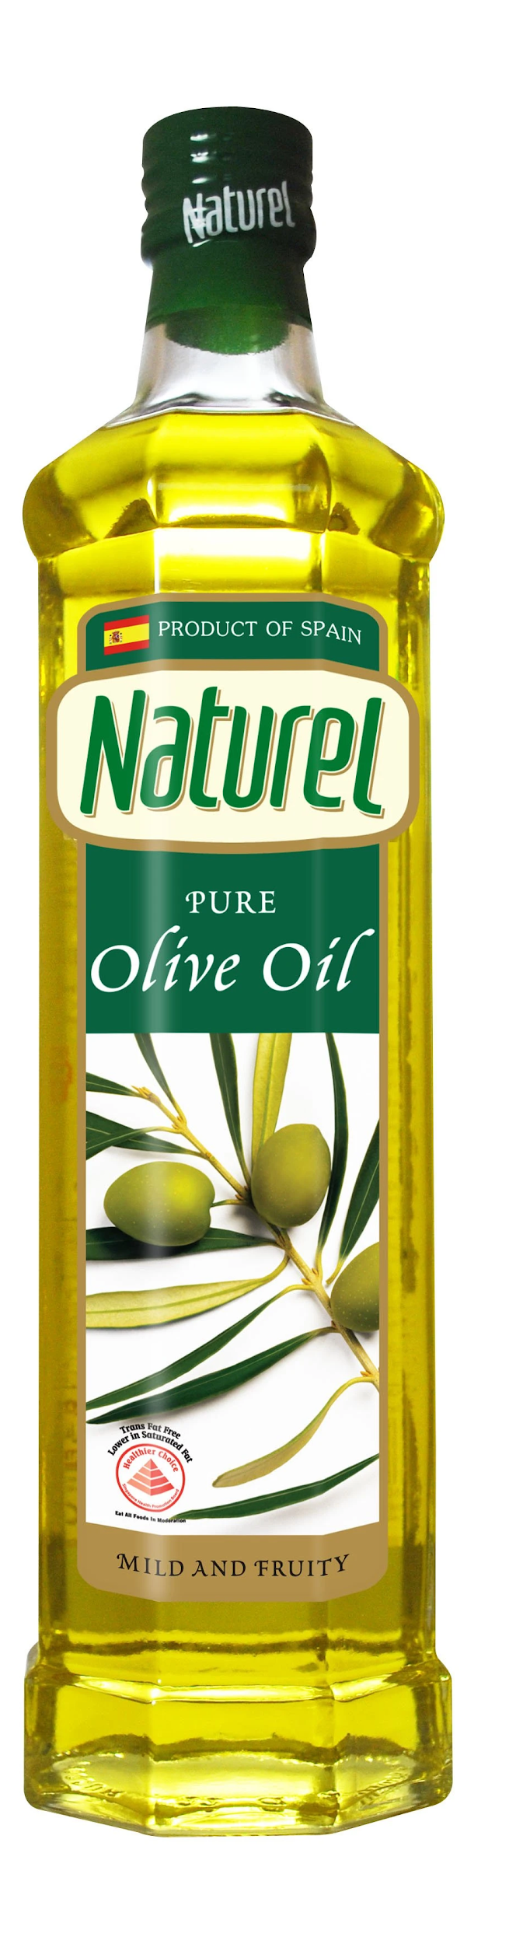
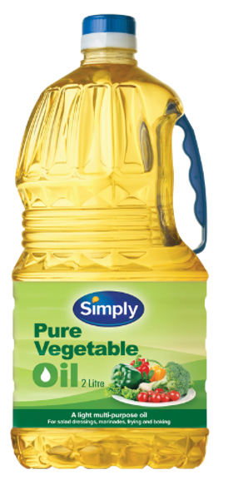
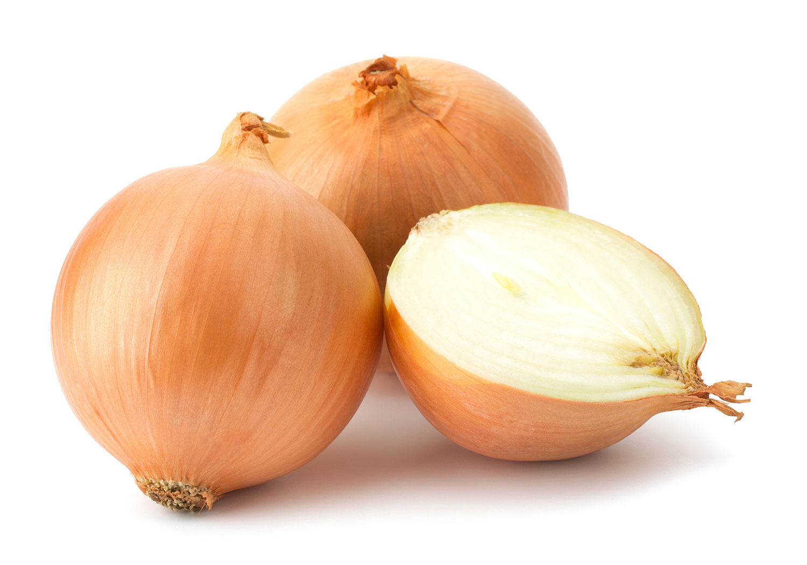
Problem 2: Which cuisines uses healthier ingredients?
Commonly Used Oil
Vegetable Oil
Olive Oil [Rich in Oleic Acid]
Onions & Olive oil are healthy ingredients
Reduces the risk of having heart diseases
Onions
Vegetable Oil
Olive Oil
Notes:
Onions & Olive oil classified as healthy ingredients by American Cancer Society.
Rich in Oleic Acid, a Very Healthy Fat

Slide 18
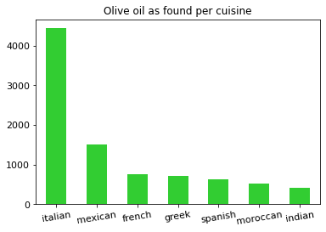
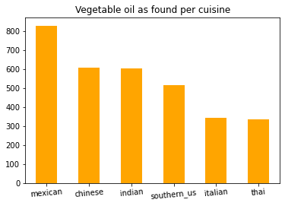
Problem 2: Which cuisines uses healthier ingredients?
602
419
Notes:
Onions & Olive oil classified as healthy ingredients by American Cancer Society.

Slide 19
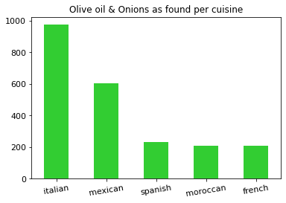
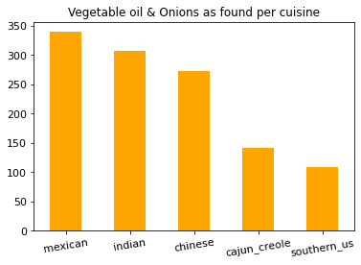
Problem 2: Which cuisines uses healthier ingredients?
Notes:
Onions & Olive oil classified as healthy ingredients by American Cancer Society.

Slide 20
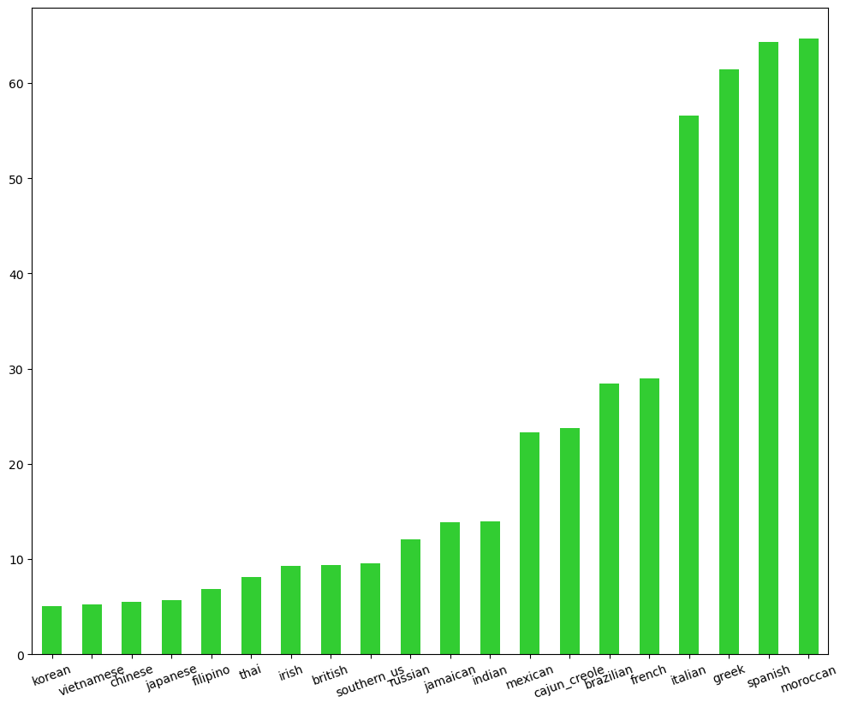
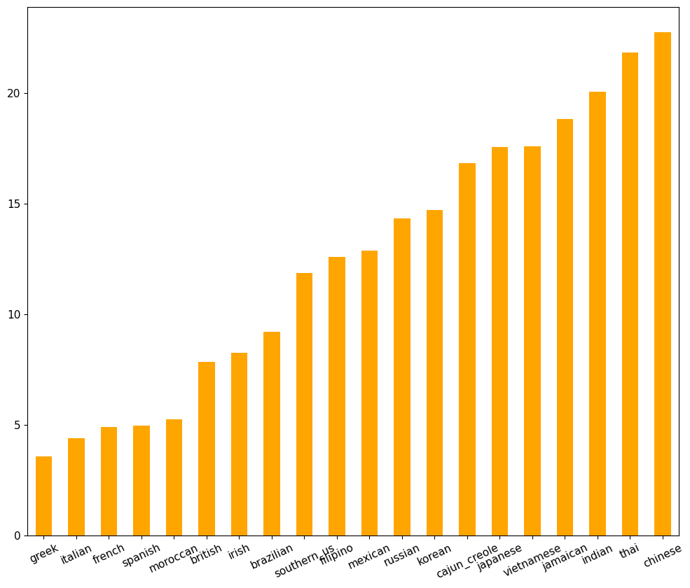
Problem 2: Which cuisines uses healthier ingredients?
Olive Oil
Vegetable Oil
Moroccan, Spanish, Greek, Italian, French
Notes:
Olive and Total

Slide 21
(5)Findings show omega-3 fatty acids may help to:
Lower blood pressure
Reduce triglycerides
Slow the development of plaque in the arteries
Reduce the chance of abnormal heart rhythm
Reduce the likelihood of heart attack and stroke
Lessen the chance of sudden cardiac death in people with heart disease
Veg vs olive(random info)
(1)While both olive and vegetable oils contain unsaturated fatty acids, olive oil contains higher amounts of monounsaturated fats like oleic acid, linoleic acid, and palmitic acid. Vegetable oil contains mostly omega-6 polyunsaturated fats.
(2)A high omega-6 fatty acid intake and a high omega-6/omega-3 ratio are associated with weight gain in both animal and human studies, whereas a high omega-3 fatty acid intake decreases the risk for weight gain. Lowering the LA/ALA ratio in animals prevents overweight and obesity.
(3)Olive Oil Is Rich in Healthy Monounsaturated Fats
About 14% of the oil is saturated fat, whereas 11% is polyunsaturated, such as omega-6 and omega-3 fatty acids (1). But the predominant fatty acid in olive oil is a monounsaturated fat called oleic acid, making up 73% of the total oil content
(4)Rich in Oleic Acid, a Very Healthy Fat
This fatty acid is also the main component of olive oil, and believed to be partly responsible for its health benefits
(6) For benefits of Oleic Acid
References.
(1)https://www.healthline.com/nutrition/olive-oil-vs-vegetable-oil#differences
(2)https://www.ncbi.nlm.nih.gov/pmc/articles/PMC4808858/#:~:text=A%20high%20omega%2D6%20fatty,animals%20prevents%20overweight%20and%20obesity.
(3)https://www.healthline.com/nutrition/extra-virgin-olive-oil#:~:text=Olive%20Oil%20Is%20Rich%20in%20Healthy%20Monounsaturated%20Fats&text=About%2014%25%20of%20the%20oil,of%20the%20total%20oil%20content.
(4)https://www.healthline.com/nutrition/11-proven-benefits-of-olive-oil#TOC_TITLE_HDR_2
(5)https://www.webmd.com/hypertension-high-blood-pressure/guide/omega-3-fish-oil-supplements-for-high-blood-pressure
(6)https://draxe.com/nutrition/oleic-acid/

Slide 22
Prediction of cuisines
Notes:
Onions & Olive oil classified as healthy ingredients by American Cancer Society.
Rich in Oleic Acid, a Very Healthy Fat

Slide 23
Problem 3
Are we able to predict the type of cuisine using the ingredient(s) given?
Notes:
Onions & Olive oil classified as healthy ingredients by American Cancer Society.
Rich in Oleic Acid, a Very Healthy Fat

Slide 24
Prediction of cuisine based on ingredients
Problem: Use Machine Learning models to process the input as the list of ingredients and make the prediction (output) of types of cuisine.
Predictors for models: List of ingredients. Label to predict: Cuisines
This is a classification problem with balanced dataset.
We have tried and realized that classification, regression and neural networks models are the most appropriate, while clustering is not suitable.
Our objective is to find the relationships between ingredients and culture, so it is crucial to prove that based on Machine Learning models.
Notes:
Classification problem is a predictive modeling problem where a class label is predicted for a given example of input data

Slide 25
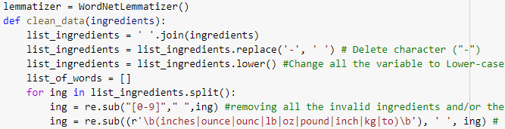
Prepare the dataset - Cleaning
1. Change the data format from list-of-list into list of string.
2. Change some unwanted word formats:
Invalid ingredients (e.g.: “mi”, “v8”)
Apostrophes (e.g.: “sheep’s milk cheese”)
Special Characters (e.g.: “!”, “%”, “&”, “1”, “2”)
Uppercase (e.g.:”English toffee bits”)
Hyphens (e.g.: “soft-boiled egg”)
Regions (e.g.: “american cheese slices”)
Units (e.g.: “pork chops, 1 inch thick”)
Numbers (e.g.: “95% lean ground beef”)
3. Remove outliers:
Remove cuisines with less than 2 ingredients, or over 59 ingredients.

Slide 26
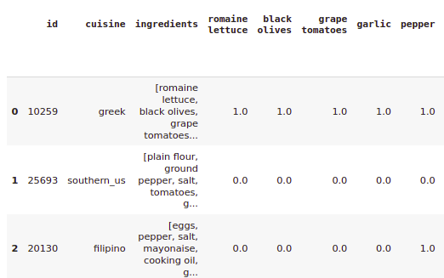
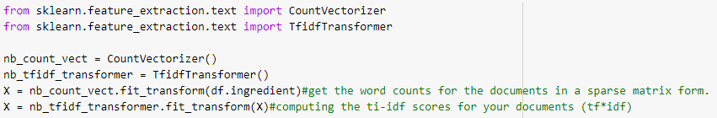
Prepare the dataset - Restructuring
Split into train (75%) and test (25%) set randomly.
Change to binary matrix format (only two digits 0-1) using One Hot Encoding process.
Notes:
One hot encoding creates new (binary) columns, indicating the presence of each possible value from the original data

Slide 27
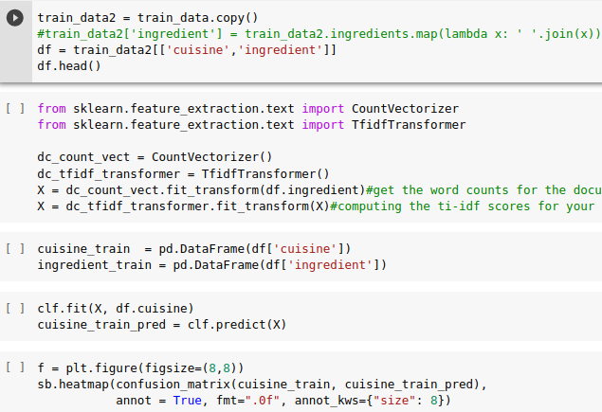
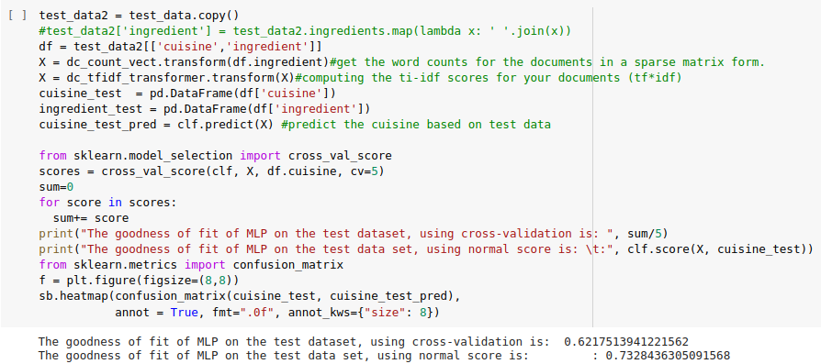
Apply Machine Learning model
Prepare dataset
Import model
Fit and predict
Print the accuracy score
Neural Networks model - MLP Classifier

Slide 28
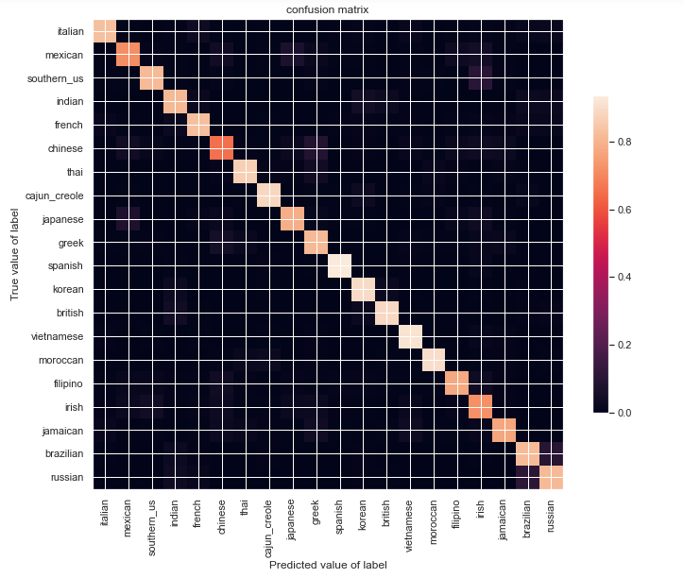
Confusion Matrix of MLP Classification

Slide 29
PREDICTION OF CUISINE BASED ON INGREDIENTS - Models’ Accuracy
Machine Learning Models | Classification Accuracy (Train Set) | Classification Accuracy (Test Set) | Cross-Validation Score (Train Set) | F1-Score (Test Set)
Decision Tree Classifier | 0.768 | 0.596 | 0.583 | 0.59
Naive Bayes Classifier | 0.685 | 0.678 | 0.660 | 0.64
Random Forest Classifier | 0.970 | 0.597 | 0.625 | 0.59
XGBoost (GradientBoostingClassifier) | 0.725 | 0.73 | 0.650 | 0.73
MLP Classifier (Neural Networks Model) | 0.792 | 0.733 | 0.724 | 0.73
Logistic Regression | 0.820 | 0.782 | 0.776 | 0.73
Notes:
Only Decision Tree are learned within the course

Slide 30
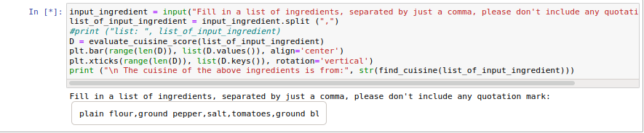
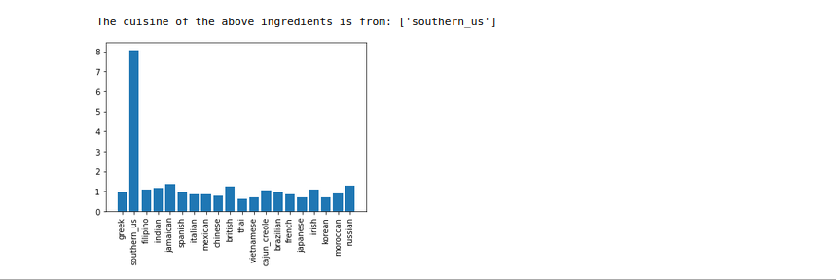
A program to predict cuisine based on user’s input

Slide 31
Key Takeaways - Machine Learning Models
Logistic Regression returns the highest accuracy, and thus being the most suitable model for this classification problem with balanced dataset.
Random Forest Classifiers in this dataset is a typical example of overfitting in train dataset. We should use cross-validation score in this case to evaluate correctly.
String dataset should be cleaned and restructured into Binary Matrix to apply Machine Learning models.
Notes:
High is not always good. 0.97 accuracy score in train dataset but just under 0.6 in test data.

Slide 32
Key Takeaways - Machine Learning Models
Why Logistic is the most suitable model for this problem?
The signal to noise ratio in this problem is low (it is a ‘hard’ problem), which makes logistic regression being likely to perform best.
The dataset is balanced.
While its name is logistic regression, it is used more for classification problem, which is binary classification.

Slide 33
Overall Learning Outcome
We have learnt how to :
Work with string-based datasets effectively
Use various visualization tools, including those beyond the course such as Word Clouds
Use Exploratory Data Analysis to analyze the healthiness of the cuisine
Use different Machine Learning Models that are beyond our course.
Write two programs to check the uniqueness of the ingredients, and predict the cuisine based on list of ingredients being input from users
Notes:
We have learnt how to use various visualization tools, including those beyond the course such as Word Clouds
We have learnt how to use Exploratory Data Analysis to analyze the healthiness of the cuisine
use different Machine Learning Models that are beyond our course.

Slide 34
Work Allocation
Daniel: Exploratory Data Analysis - General Analysis
Sailesh: Exploratory Data Analysis - Cultural Analysis
Wei Teck: Exploratory Data Analysis - Healthiness of different cuisines
Bui Quang Huy: Data cleaning and Machine Learning Models

Slide 35
Work Allocation
Daniel: Exploratory Data Analysis - General Analysis
Sailesh: Exploratory Data Analysis - Cultural Analysis
Wei Teck: Exploratory Data Analysis - Healthiness of different cuisines
Bui Quang Huy: Data cleaning and Machine Learning Models

